Slide 1
International Pathogen Surveillance Network WHO IPSN Overview of Global Pathogen Genomics Toolkit & Use Cases
Pathogen Genomics Priorization and Implementation Workshop
Bangkok 9-13 September 2024
Dr. Homa Attar Cohen
Senior Technical Advisor to IPSN
attarcohenh@who.int

Slide 2


The rapid expansion of pathogen genomics since 2019 presents an opportunity to build truly global coverage
Genomic sequencing technology has rapidly developed in recent years allowing lower cost, higher volume pathogen analysis
There is now an opportunity
to create an interlinked network of high-quality pathogen genomics systems, reducing the burden of future pandemics and endemic diseases
COVID-19 provided an important test case, leading to a rapid build-out of capacity worldwide

Slide 3
The IPSN is a global network bringing together the pathogen genomic community to improve public health decision making
Vision
Mission
Every country has equitable access to sustained capacity for genomic sequencing and analytics as part of its public health surveillance system.
Engage a mutually supportive global network of genomic surveillance actors that amplifies and accelerates the work of its members to improve access and equity.

Slide 4
The IPSN increases pathogen genomic surveillance harmonization, scale and political attention
What will the IPSN deliver?
What impacts will the IPSN have?
Increased harmonization and innovation in pathogen genomics
Increased scale and efficiency of country capacity building efforts
Increased political attention and financing coordination and sustainability
Stronger national, regional and international surveillance systems better able to detect and characterize new threats and reduce disease burden
Health systems are better able to coordinate rapidly during an outbreak to detect and respond to emerging threats

Slide 5


What the IPSN is
What the IPSN is not
New global network
Focused on pathogen genomics
Bringing together pathogen genomic actors
Supporting countries by engaging all relevant stakeholders
Convening, facilitating, enabling and supporting countries to plan
Supporting the development of bioinformatics tools by partners
Replicating other stakeholder activities
Limiting its engagement to WHO staff and member states
Actively implementing PGS programs
Training country lab staff
Funding delivery of genomic surveillance systems
Housing data or developing software

Slide 6





The IPSN convenes technical, policy and financing communities together to deliver on global priorities
Who is the IPSN?
What does the IPSN do?
A network of pathogen genomic communities, including:
National and regional public health systems
Animal and environmental sectors
Policy makers and donors
Academic groups
Private sector business associations
Civil society
International standard organizations
Communities of Practice to solve common challenges
Country Scale-up Accelerator to enable exchange & amplify country voices
Catalytic grant fund to support member projects
Advocacy & communications to keep pathogen genomics high on the agenda
Convene partners to share progress and innovations
Convened and supported by a Secretariat led by the WHO Pandemic Hub

Slide 8
The IPSN aims to amplify and accelerate the work of its members
IPSN members are already leading many critical pieces of work…
Work at the country level
Work at the regional level
Global programs
Surveillance system planning and budgeting
Day-to-day running of surveillance systems
Public health decision making
National research and innovation programs
Networks to share best practices and pool resources
Support for country planning and decision making
Regional reference labs, data analysis support
Global disease programs
Academic programs
Standard setting initiatives e.g. PHA4GE, GA4GH
Bilateral, multilateral and philanthropic funders
… which IPSN aims to amplify and accelerate

Slide 9
The IPSN convenes technical, policy and financing communities together to deliver on global priorities
What does the IPSN do?
Communities of Practice to solve common challenges
Country Scale-up Accelerator to enable exchange & amplify country voices
Catalytic grant fund to support member projects
Advocacy & communications to keep pathogen genomics high on the agenda
Convene partners to share progress and innovations
Convened and supported by a Secretariat led by the WHO Pandemic Hub

Slide 10


The IPSN’s operational bodies advance pathogen genomic surveillance
Country Scale-Up Accelerator
COP pathogen genomic data
COP environmental and vector genomic surveillance
Focusing on creating global goods to support country capacity and promote network exchange
Communities of practice are established to bring together groups of IPSN partners to work together on common challenges
Purpose
Country capacity framework
Global investment case for pathogen genomic surveillance
Use-case definition and prioritization
Coordinate action to avoid duplication
Secretariat brokers new relationships
Data principles & standards to foster trust among data stakeholders and enhance data connectivity for better analysis
Data sharing to implement agreements on data production, sharing, and utilization
Data analytics to define an open bioinformatics ecosystem and explore data-analytics interoperability
Harmonize data with technical innovation
Provide technical support for standards
Define cost-effective use cases in public health surveillance
Investigate ethical sampling and data use
Encourage intersectoral collab. with One Health approach
Areas of focus
Notes:
IPSN’s operational bodies include:
Country Scale Up Accelerator
Focusing on creating global goods to support country capacity and promote network exchange
Trough the CSUA we are hosting a set of Webinars on the use of PGS with the vertical programs at WHO. The first one to be on Dengue on August
COP on PG Data: working on data standards, data analytics and data sharing
Trough this body, it is IPSN is supporting the development of a global, equitable bioinformatics ecosystem with an on-going expert consultation on developing a community accepted model of a future bioinformatics ecosystem to align capacity building, workforce development, funding and prioritisation
And the development of new WHO document on genomic data sharing platforms Collaboration with WHO Emerging Zoonotic Diseases team that operationalizes the WHO guiding principles for pathogen genome data sharing published in 2022, describing desired attributes of genomic data sharing platforms supporting surveillance of pathogens with epidemic and pandemic potential.
We are stablishing a COP on environmental including WWS and vector genomics surveillance to catalyze the use of genomics and define cost effective use cases in

Slide 11




The Country Scale-Up Accelerator focuses on global goods and innovation to tackle challenges in country capacity
Challenge
Current efforts and gaps
Impact areas
Resources
insufficient
and may not be
sustainable
Domestic and donor budgets have grown but still too few countries have well-developed systems to properly coordinate funding
Countries may not always see sufficient value in maintaining investments in “peacetime”
Global goods that can benefit countries and development actors, including:
A country capacity framework outlining different archetypes that countries inhabit across diverse budgetary levels
A global investment case for pathogen genomic surveillance
Use-case models that demonstrate the optimal use of genomics – and the ROI – in different country contexts
Country
Investments not
always optimally
coordinated
Hardware procurement has often moved faster than human capital, or sequencing volumes have overtaken bioinformatics
Many trainings
but limited
attention to
career paths
NPHIs have many trainings to chose from, but limited focus in strengthening the workforce i.e., addressing the workforce competency gaps
Supporting delivery:
Coordinated action for target countries, aligning existing actors and ensuring no overlap or gaps
Secretariat provides brokering function to establish new relationships
Unharnessed
‘supply’ of peer-
to-peer support
A range of skilled actors, esp. in LMICs, are willing and able to support other NPHIs but may require support brokering connections, and small amounts of funding

Slide 12









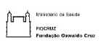














24 organizations have agreed to be partners to the IPSN Country Scale-up Accelerator
Inter/governmental / governmental
Academic institutions
Non-governmental organizations
African Centers for Disease Control & Prevention
ANLIS Malbrán
Asia Pathogen Genomics Initiative
Fiocruz
Food and Agricultural Organization
Korea Disease Control and Prevention Agency
Nigeria Centre for Disease Control and Prevention
Robert Koch Institute
Rwanda Biomedical Centre
UK Health Security Agency
UK Department of Health and Social Care
US Centers for Disease Control and Prevention
American University of Beirut
Asia-Pacific Pathogen Genomics Network
Centre for Epidemic Response and Innovation
Chan Zuckerberg Biohub
Institute of Genomics and Integrative Biology
Duke NUS Medical School
Medical Research Council Unit The Gambia, LSHTM
Peking University
Tata Institute for Genetics and Society
Infectious Disease Institute, Makerere University
Wellcome Connecting Sciences
Wellcome Sanger Institute
WHO regional offices involved in CSUA

Slide 13
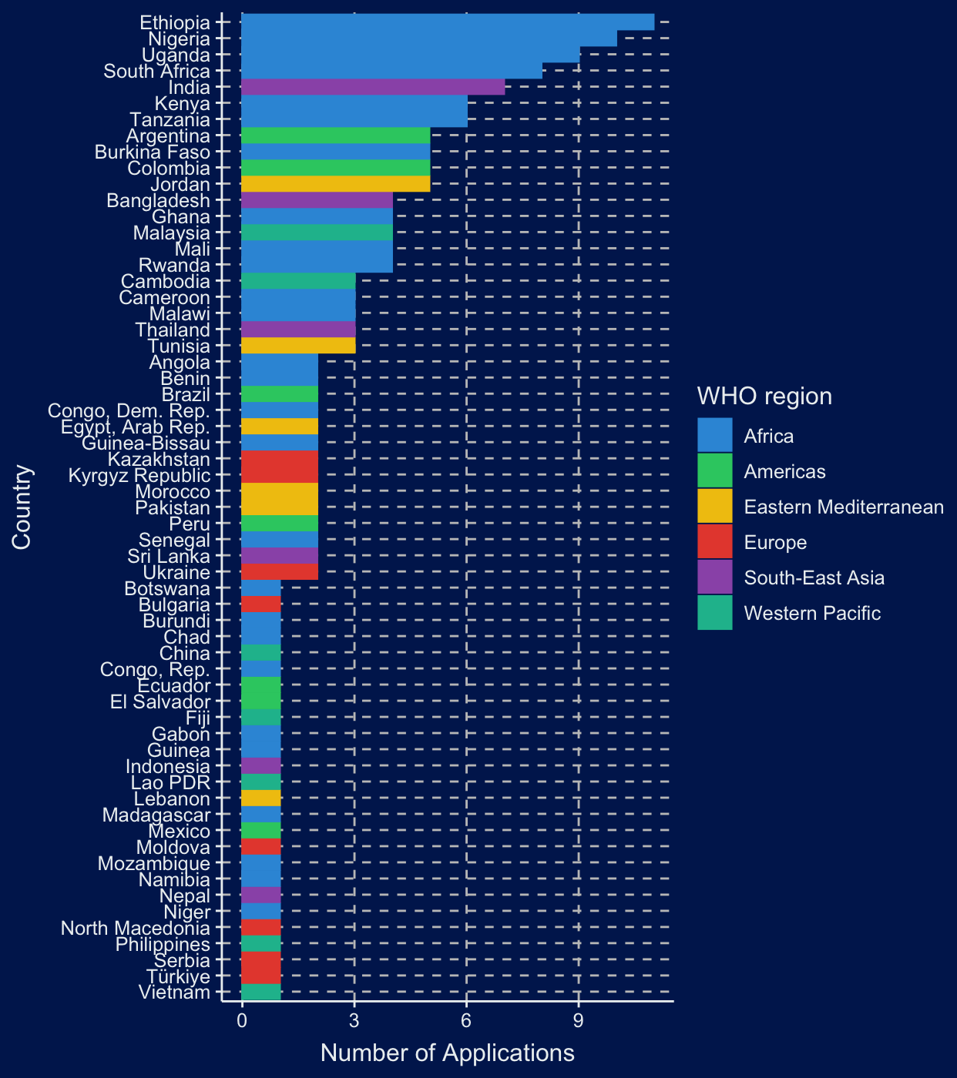
Catalytic Grants Fund
166 eligible* concept notes from 61 countries
More eligible applications from AFRO than from all the other regions combined.
WHO Region | n
AFR | 93
SEAR | 18
AMR | 17
EMR | 15
WPR | 12
EUR | 11

Slide 14



The IPSN Funders Forum can maximize the impact of the IPSN by providing catalytic support and increasing coordination
Challenge
Current efforts and gaps
Areas of work for the Funders Forum
Country capacity
remains uneven;
efforts are
increasing but
uncoordinated
Too few countries can do sequencing at scale
Bioinformatics and links to public health decision making often lag behind sequencing output
Donor support efforts have limited coverage
Risk to sustainability of domestic and donor financing
Catalytic grant funding to support the activities of the IPSN and ensure there is equity of participation
Lots of innovation
and good practices
but limited knowledge
sharing
Limited sharing btw human, environmental & animal health systems, disease areas, academia & public health
Attempts to work across siloes within more limited geographies (e.g., US CDC AMD, ACDC IPG)
No global connector to support harmonization
Identify and coordinate around larger funding opportunities
Data sharing burdened
by problems at all
levels
(technical, political,
bureaucratic)
Insufficient incentives to share data internationally
PIP* was positive step for flu but in many countries & disease areas there remains no agreed framework
Need for WHO as global normative body to ensure trust & global scope of sharing
* PIP : Pandemic Influenza Preparedness Framework

Slide 15









A suite of tools elaborated by IPSN in collaboration with members and partners, and partner-led tools supported by IPSN
Global investment case
Country capacity framework
Lab costing tool
IPSN Secretariat- supported products
WHO Global Strategy- driven products
PGS uses framework
Global data sharing attributes
Bio-informatics landscaping
Partner- driven products
M&E framework
Workforce training/ competencies framework
Sampling framework
Prioritization tool

Slide 16
As next steps, the IPSN toolkit will be consulted on with regions and countries
Process and next steps:
What we will be asking:
Finalization of technical documents
Consult with regions
Country pilots/tests
Prepare for publication
Which countries do you suggest for piloting ?
How can the products be used in your region?
Do they help to increase equitable and sustainable access to PGS?
How can the products be improved to better serve country needs?
Draft technical documents to accompany frameworks are developed
Draft technical documents are refined with feedback and input by regions
Products are tested by pilot countries and feedback is incorporated
Products are finalized and prepared for publication

Slide 17
The IPSN Global Partners Forum 2024 will bring partners together to discuss the biggest issues in pathogen genomics
Objectives
Bring together IPSN partners to:
Showcasing the toolkit of various products developed by the IPSN Secretariat
Announcement of the first funding round of the IPSN’s catalytic grant fund
Reflecting on the journey of the IPSN from launch to delivery and the growth pathway ahead
Format
Week-long event with plenaries, breakout sessions, and workshops including:
Global Partners’ Forum over 1.5 days
Competency and Training Workshop over 2 days
Costing Tools Workshop 2.0 over 1.5 days
Logistics
Location: Bangkok
Dates: 21-22 November 2024

Slide 18
Pathogen Genomics Uses

Slide 19


The IPSN is developing key global goods defined as priorities by its members
The Country Capacity Framework
The Global Investment Case
PGS Uses
A framework that lays out the different archetypes that countries can occupy at different budget levels, to ensure equitable access to PGS as part of their public health system
A powerful, fact-based case for the investment needed in pathogen genomic surveillance at the global level, based on analysis of the additional costs required, and the impact of these investments
A comprehensive definition of the uses for pathogen genomic surveillance to identify patterns, gaps and examples that support country-level implementation and advocacy

Slide 20



Pathogen genomics uses framework addresses several objectives
Gives a comprehensive view of how PGS may and is being used
Scope incl. pathogens with pandemic potential & endemic diseases
Providing a list of pathogens for experts to see how their expertise can support all others, and create synergies
From single- to agnostic pathogen surveillance
Comprehensive and vertical view allows for interpretation of patterns across pathogens
Allows to see patterns across genomic objectives and pathogens, and contribute to more efficient planning and deployment of PGS use
Contributes to advocacy efforts
The framework can be leveraged for building products such as investment cases
Can be used for communications and advocacy for national and international funding

Slide 21
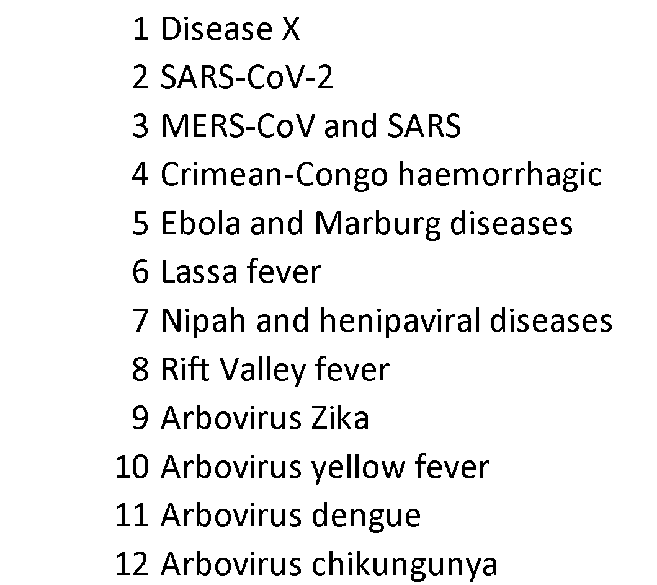
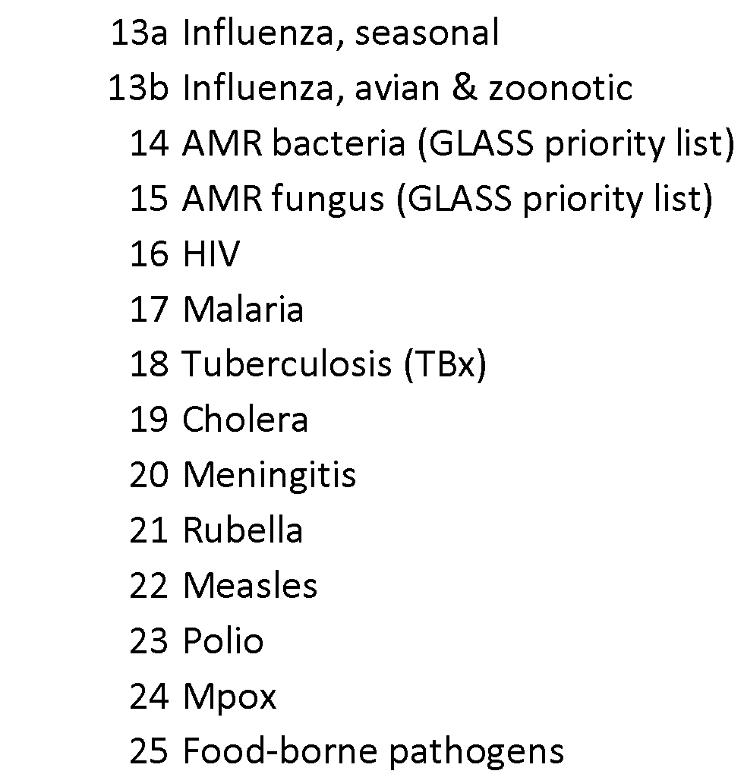
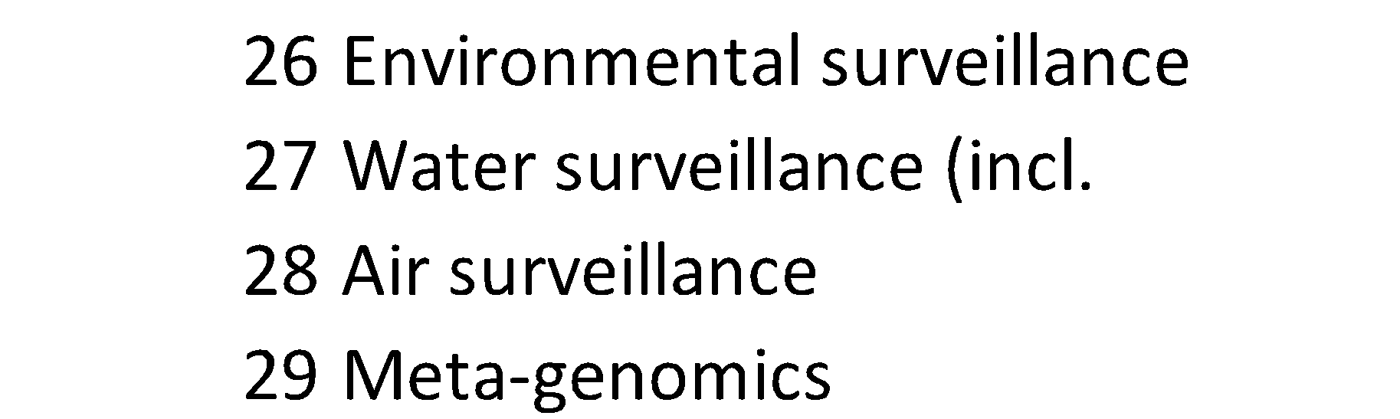
The framework uses a wide but not exhaustive list of WHO priority pathogens and pathogen-agnostic approaches
Pathogens with pandemic potential (from R&D Blueprint)
Endemic pathogens endemic & those integrated in programs
Pathogen-agnostic approaches

Slide 22
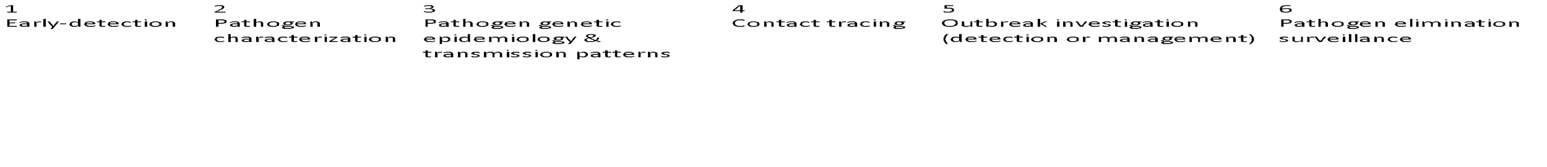
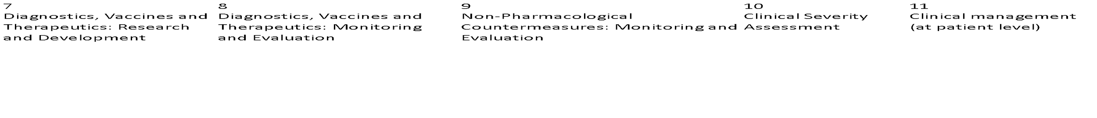
The UCF considers 11 different surveillance objectives for the use of genomics
Routine Public Health Practice
Special studies Clinical management

Slide 23
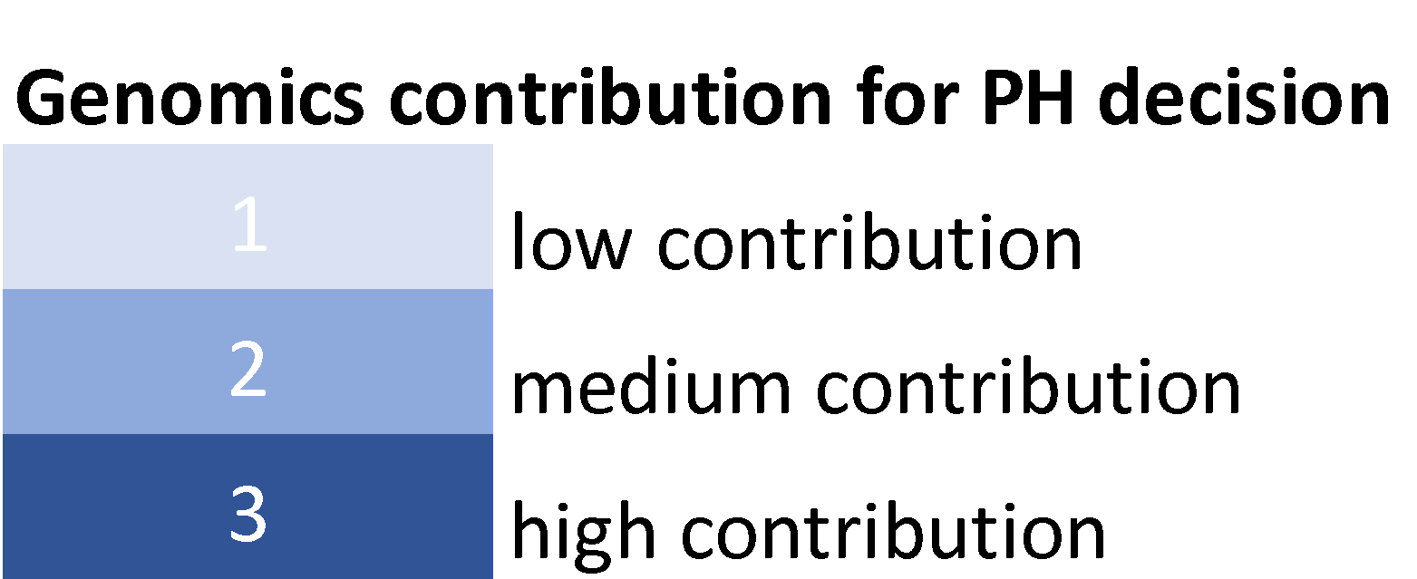
Estimations on Genomics contribution to PH
To what extent does genomics contribute to surveillance and public health?

Slide 24
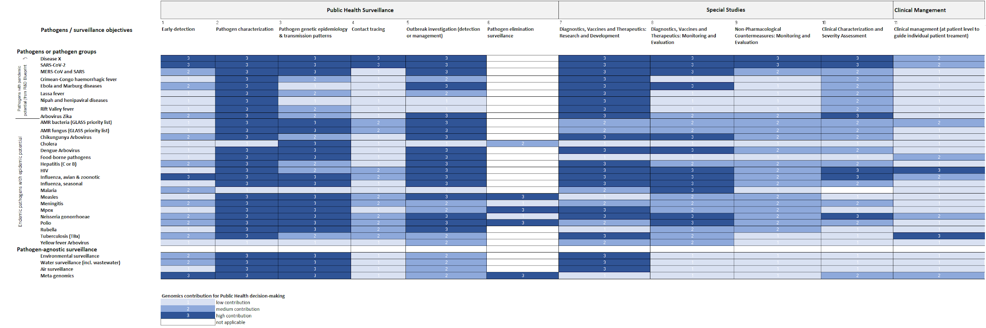
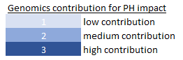
The levels of contribution of genomics per pathogen and surveillance objectives for public health decision-making
Vertical, horizontal and diagonal read-outs

Slide 25
As next steps, the IPSN toolkit will be consulted on with regions and countries
Process and next steps:
Finalization of technical documents
Consult with regions
Country pilots/tests
Prepare for publication
Global Partners Forum
Draft technical documents to accompany frameworks are developed
Draft technical documents are refined with feedback and input by regions
Products are tested by pilot countries and feedback is incorporated
Products are finalized and prepared for publication

Slide 26

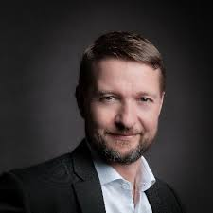
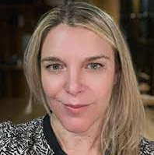
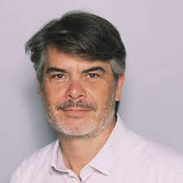
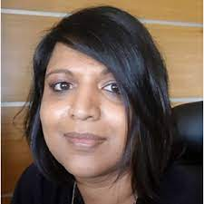
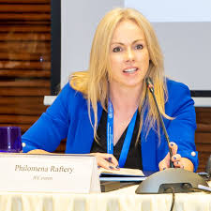
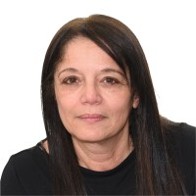
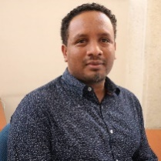
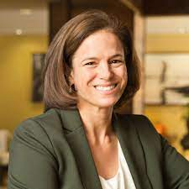
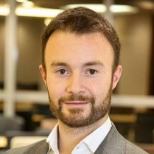


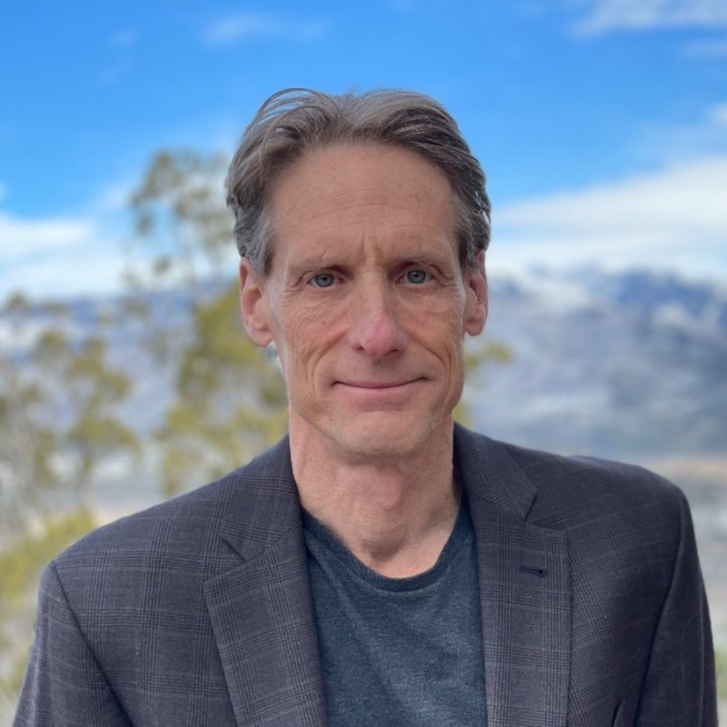
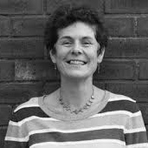

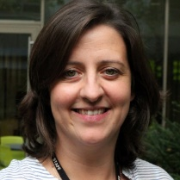




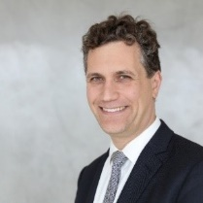


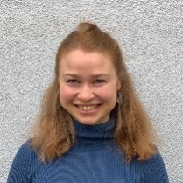
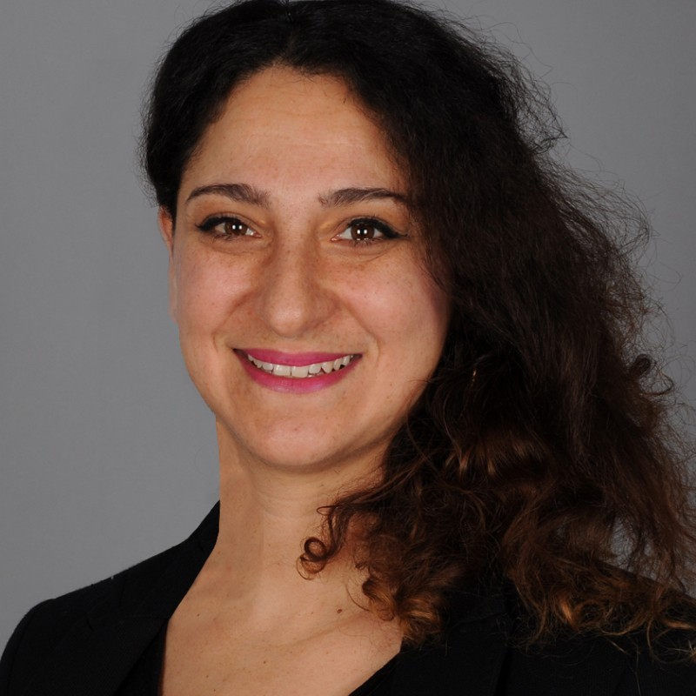

The Secretariat, encompassing core staff and partners
Internal WHO
External
The IPSN Secretariat team has expanded to support a larger ongoing scope of work
The IPSN Secretariat is supported by technical advisors from across WHO and partner organizations
Informal technical working groups have been formed with partners for select projects

Slide 27

Become a member ?
1
2
3
Sign your organization up online
Provide further organizational information
Become an official member
Go to who.int/initiatives/international-pathogen-surveillance-network
Fill in the form to apply for your organization to join the IPSN as an official member
Depending on your organization type, you might need to provide more information on your organization background
The IPSN Secretariat will confirm your organization’s official membership

